Slide 1

Interview Prep Book Club – Day 8

Slide 2

Agenda
Resume Writing
https://www.techinterviewhandbook.org/resume/
https://www.youtube.com/watch?v=Tt08KmFfIYQ
Behavioral interviews
https://www.techinterviewhandbook.org/behavioral-interview/
https://www.youtube.com/@DanCroitor/videos
Coding interviews
https://frontendmasters.com/courses/algorithms/
https://www.techinterviewhandbook.org/algorithms/study-cheatsheet/
https://www.techinterviewhandbook.org/grind75
https://neetcode.io/ | https://leetcode.com/problems/
System design interview
https://www.youtube.com/watch?v=o-k7h2G3Gco
https://www.youtube.com/@SDFC

Slide 3
Scale From Zero To Millions Of Users https://bytebytego.com/courses/system-design-interview/scale-from-zero-to-millions-of-users
Single Server to Database Integration ( paradigms )
Vertical vs Horizontal Scaling
Load Balancer
Data Replication – Read Replica
Cache
CDN
Stateful vs Stateless
Multi-AZ
Message Queues
Logging, tracing, metrics, automation
Sharding / Hashing

Slide 4
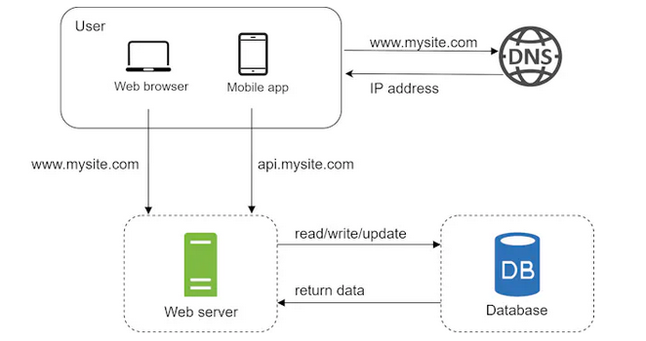
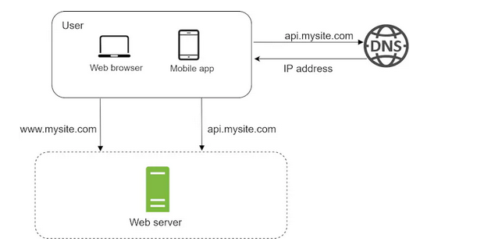
Single Server to Database Integration ( paradigms )

Slide 5
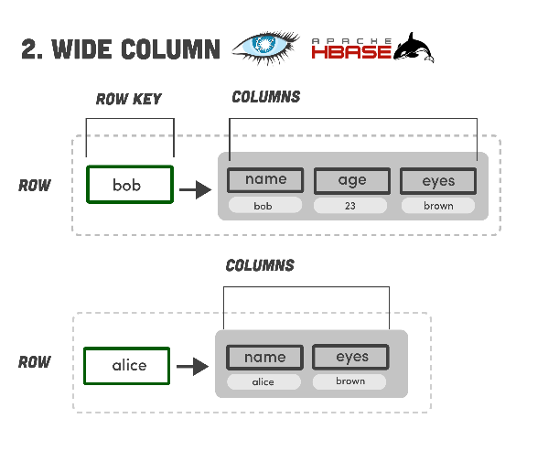
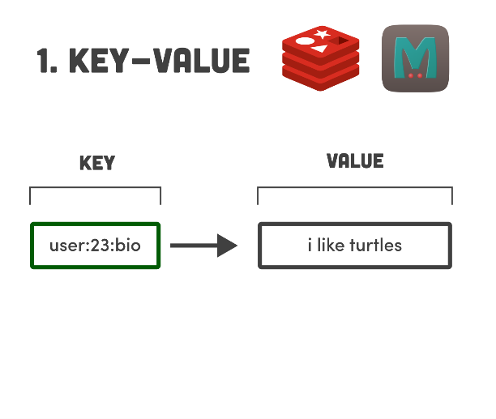
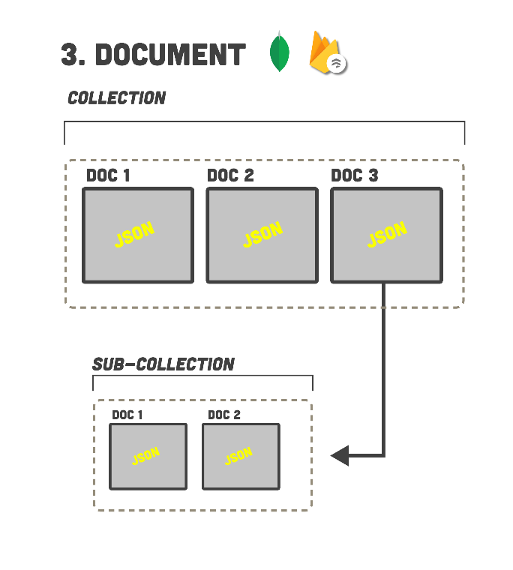
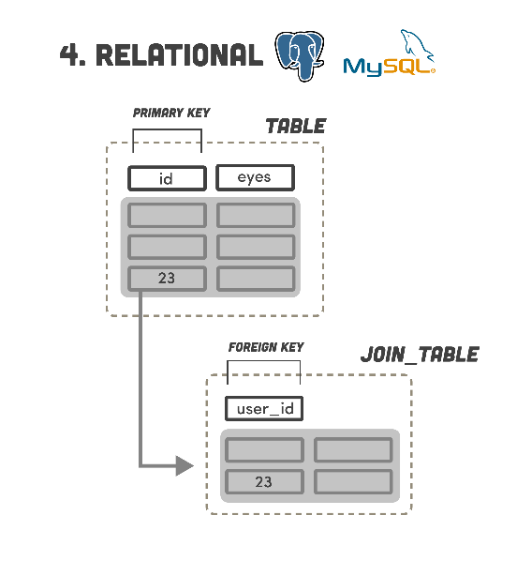
Database Paradigms https://www.youtube.com/watch?v=W2Z7fbCLSTw

Slide 6
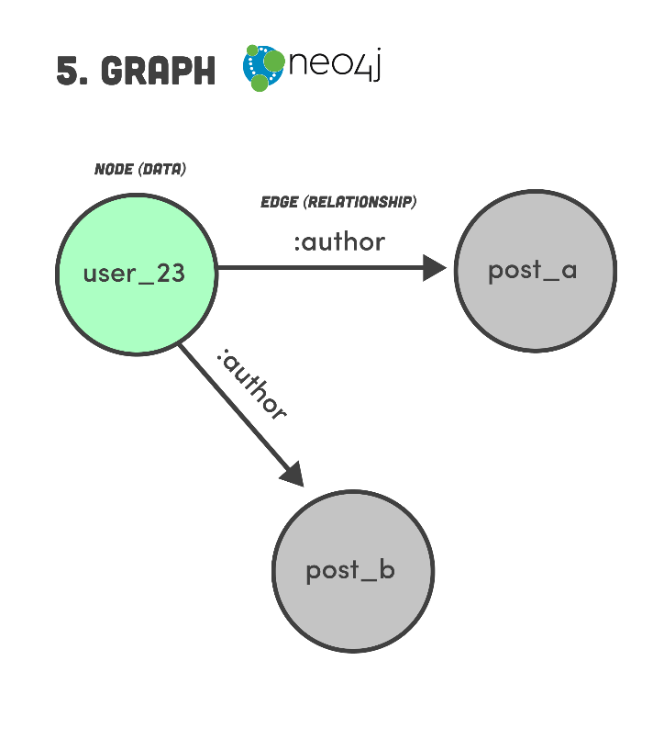
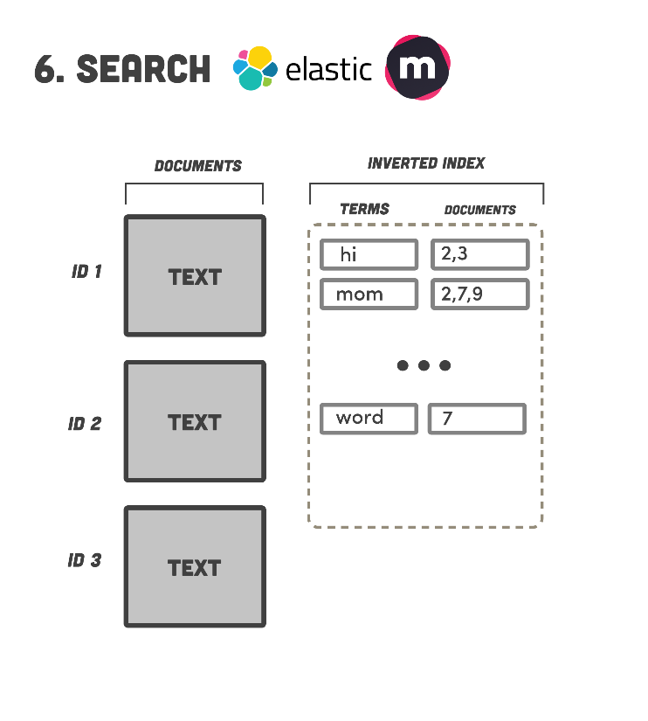
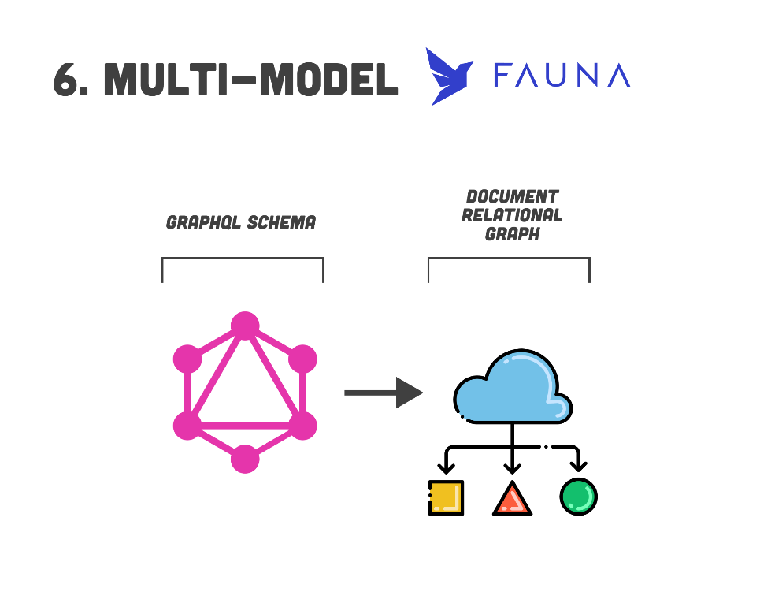
Database Paradigms https://www.youtube.com/watch?v=W2Z7fbCLSTw

Slide 7
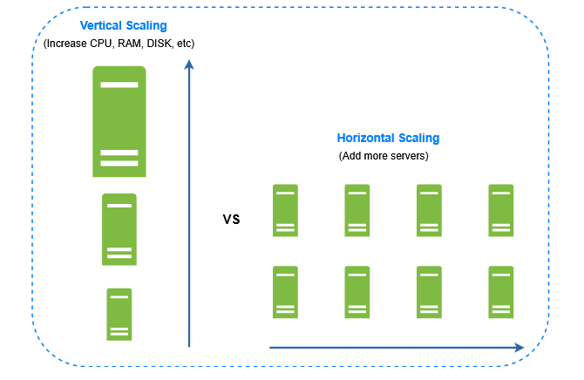
Vertical vs Horizontal Scaling

Slide 8
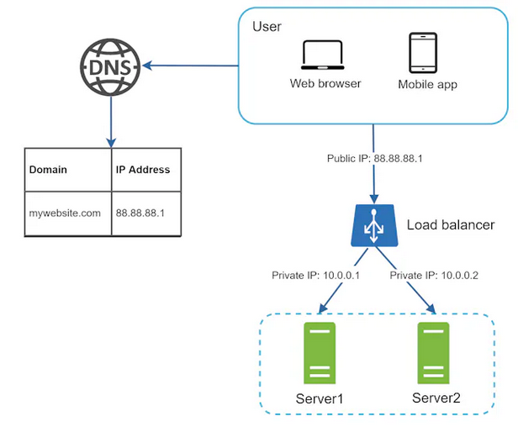
Load Balancer
https://aws.amazon.com/elasticloadbalancing/
https://www.nginx.com/
https://www.haproxy.org/

Slide 9
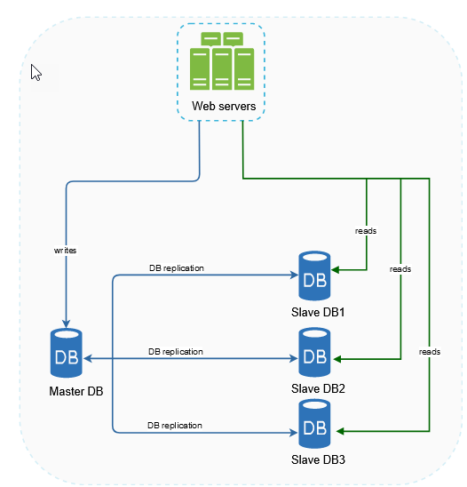
Data Replication – Read Replica
https://aws.amazon.com/rds/features/read-replicas/

Slide 10
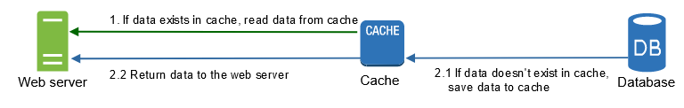
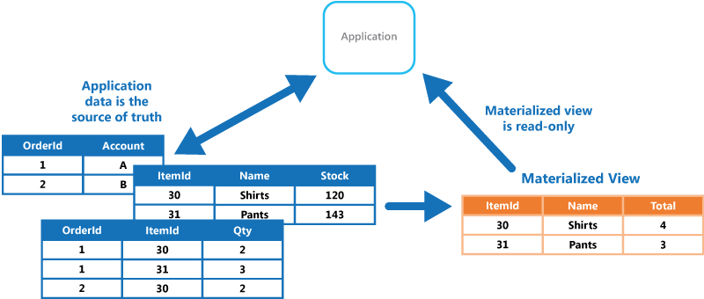
Cache
https://docs.aws.amazon.com/AmazonElastiCache/latest/red-ug/WhatIs.corecomponents.html

Slide 11
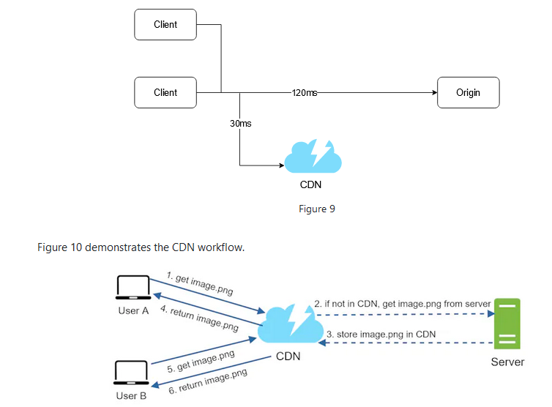
Content delivery network (CDN)
https://aws.amazon.com/cloudfront/

Slide 12
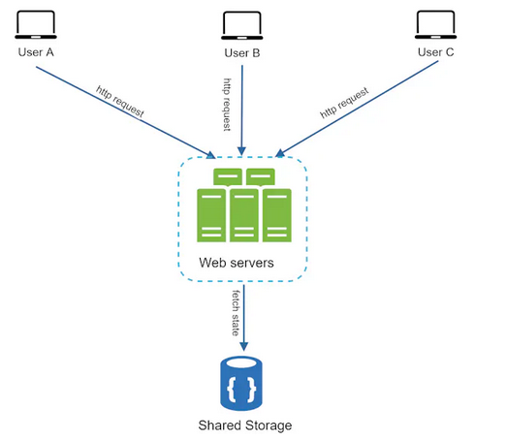
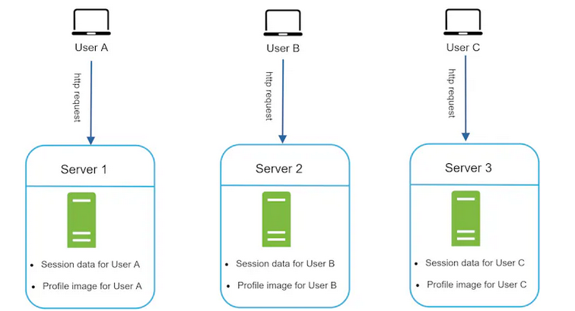
Stateful vs Stateless

Slide 13
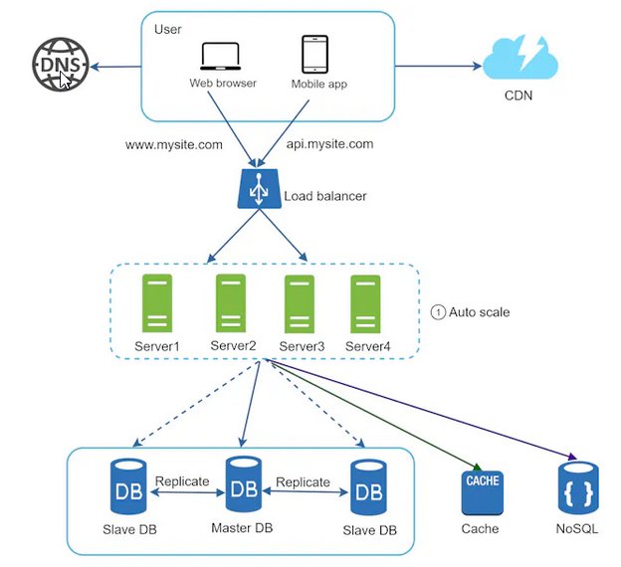
Current Topology

Slide 14
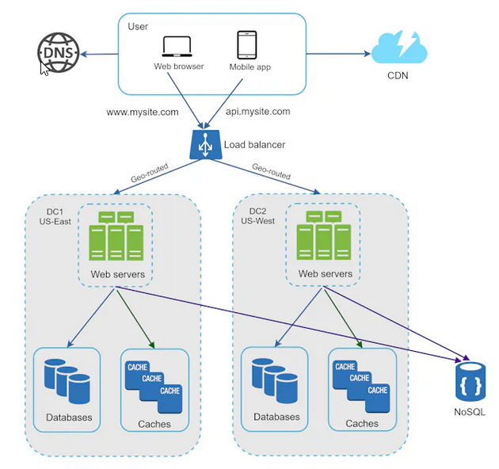
Multi-AZ
https://aws.amazon.com/rds/features/read-replicas/

Slide 15
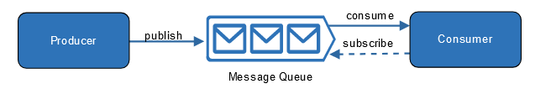
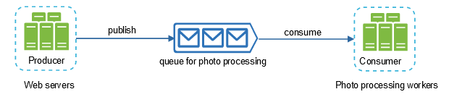
Queues Pubsub Kafka

Slide 16
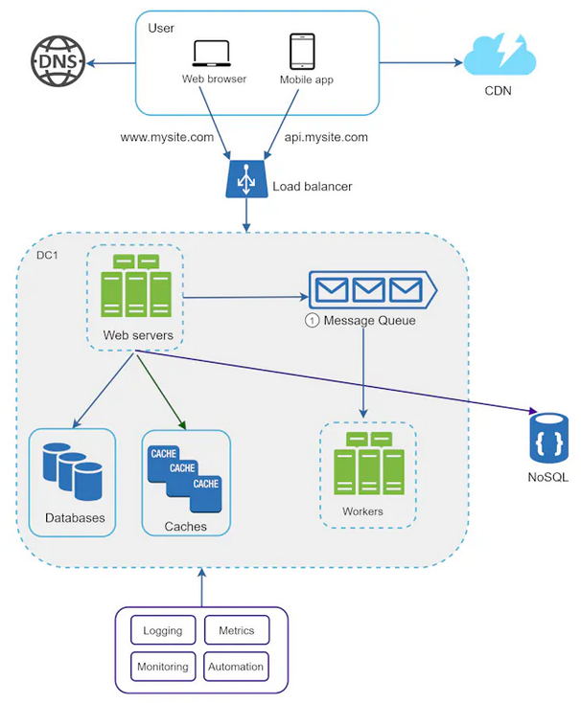
Logging, tracing, metrics, automation https://opentelemetry.io/ https://prometheus.io/

Slide 17
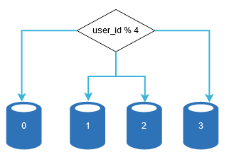
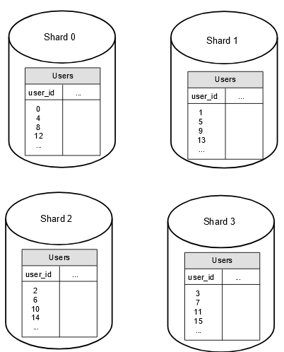
Sharding / Hashing https://www.ibm.com/docs/en/streams/4.3.0?topic=334-geohashes https://aws.amazon.com/what-is/database-sharding/

Slide 18
Suggested books
System Design Interview
System Design Interview 2
The Phoenix Project
Designing Data-Intensive Applications *

